Slide 1
Benchmarking Platform: A New Tool for Child Life
Child Life Professional Data Center:
Program and Productivity Data
Notes:
Welcome!
The purpose of this webinar is to both introduce you to the process to develop the Benchmarking platform and to educate you on the different types of data that will be collected and how to get started entering data.

Slide 2
Webinar Objectives
Development of survey questions and platform
Research drives data collection
Managing staff response
Introduction of platform data collection
Plan for future education
Notes:
In an effort to break down the information that is covered during the webinar, the following objectives will be addressed. Each section covers:
Why are we using this platform and why we are talking about it…
Explain the use of both published empirical research and evidence based practice to inform the metrics, what we are collecting and measuring, of the database
How do you get your staff on board…What is this? And how do I do it?
These concepts are different some collect a lot of detail, some collect minimal, and some collect nothing….
Anticipating how your staff is going to react is why we use the inside out model…Managing staff response regarding data collection…because we know this is a culture change
Showcase the landing page, different sections of the platform, including a glance at the analytics section
Explain the process developed by the Benchmarking subcommittee to support members during the first year of use.

Slide 3
Scientific Advancement of Professional Practice Committee
SAPP Committee- Kate Shamszad and Quinn Franklin
Board Liaison- Anne Claire Hickman
Research Proposal Sub-Committee- Jennifer Staab and Ali Christler
Education, Outreach, and Awareness Sub-Committee- Annette Bonjour and Emily Jones
Benchmarking and Database Sub-Committee-Patrice Brylske and Michael Towne
Staff Liaison- Meagan Roloff
To create research, EBP, and QI proposals for the CLC, along with developing a sustainability plan for revisiting and updating related documents or work.
To make the membership aware of research, QI processes, and maintain a platform that supports networking of child life professionals interested in the topic.
To help promote and build the skill set of professional members related to research/EBP/QI through education offerings and mentorship.
To develop and oversee a benchmarking and research data center
The SAPP Committee will support ACLP’s strategic plan by promoting, encouraging, and educating the membership regarding all aspects of research, EBP, and scholarly publication and presentation
Notes:
It is extremely important to acknowledge the work of many committed ACLP members who have contributed to this effort in the past year. The Research Mega Committee was renamed SAPPC to better reflect the current work of the subcommittees as well as the vision for the future needs of or organzition.
The Steering Committee is chaired by, chair elect. Board Liaison, Staff Liason. None of this work would not have been possible without the true partnership with the ACLP office via Meagan.
The Benchmarking SubC is chaired by, chair elect. These folks have served as the Project Management Team, under Kate’s amazing leadership for this project. The PMT worked in concert with the benchmarking subcommittee to review survey questions, prepare for and participate in the Beta testing, develop educational and support documents. Their role will continue past go live and into the future!
It is important to thank and acknowledge the work that happened last summer by the other two sub committees. ____&____. They graciously put aside their charges, and set forth on an aggressive timeline to search for the evidence we needed to make decisions regarding what to measure and where to measure it. Without their work, none of this would be possible.

Slide 4
Benchmarking- Past How did we tell our story?
Share the impact of our work through anecdotes and stories
Collect quotes, letters of support, staff testimonies
Recommend a staffing ratio- 15:1 or adjusted based on location: AAP Statement
Piloted data collection across pilot sites to compare “Apples” to “Apples”: Benchmarking Task Force (2010 – 2014)
Notes:
There are many ways that we have told the story of the capacity for patient and family impact to date. There is tremendous power behind the stories families tell in thank you letters, testimonials, quotes. Staff stories can also serve as the needed information to move an Administrator or Donor closer to funding a position or program. While these tools will always serve us well, and some say are most powerful, many in our profession believe we are still missing a big piece to the puzzle.
We all have used and will continue to use the AAP statement on CL Services. This respected document, in addition to other published research, will continue to be a part of the foundation for how we advocate for services for children and families. But, this is the age of data driven decisions. Many in our profession believe that we too need “big data” if you will, backed by research, to tell out story. In fact, the AAP is now requesting us to produce such evidence to maintain the 15:1 ratio when the statement undergoes it’s next revision.
It is important to acknowledge the important work of the Patient Ratio Task Force. Between 2010-14, this group of volunteers set forth to evaluate how our peer colleagues in healthcare settings collect programmatic and productivity data, developed a comprehensive list of survey questions on those topics and even piloted out our tool via Survey Monkey! This work set the stage for the work picked up on May of 2016.

Slide 5
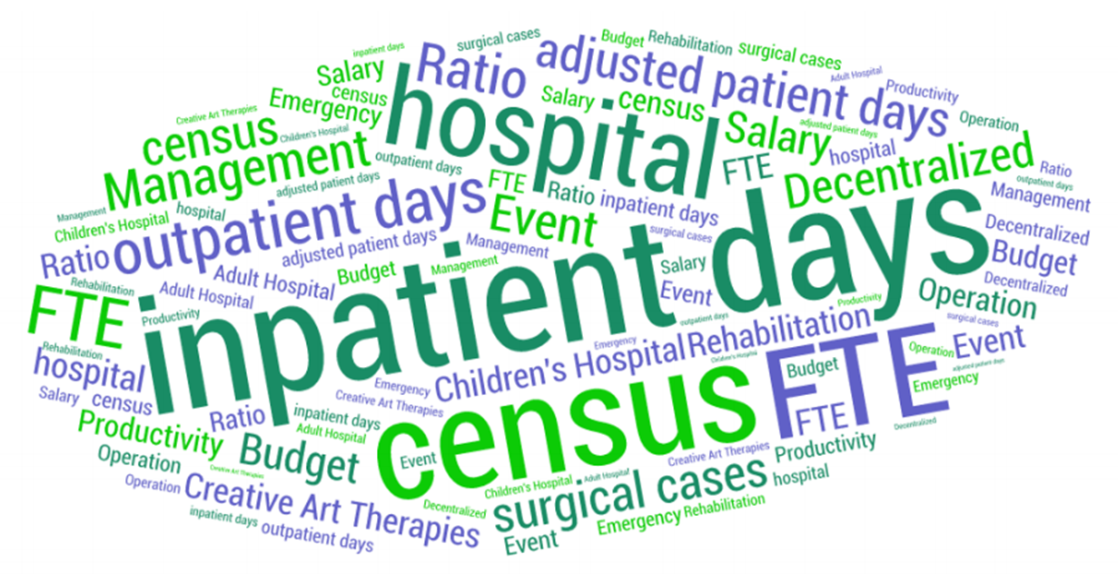
What data has been collected in the past?
Notes:
Historically, the terms on this slide have been and are still used by different hospitals to drive both benchmarking initiatives, institutional changes….these terms represent what we want to know about, and how our facilities talk about hospital level productivity. Some terms and the metrics they represent are even used to determine FY FTE’s and budgets. This is a noisy slide, reflecting many ways of measurement. But, in order to harness the power from our collective programs, we need to agree on the data that is most important to us and the way to measure it.

Slide 6
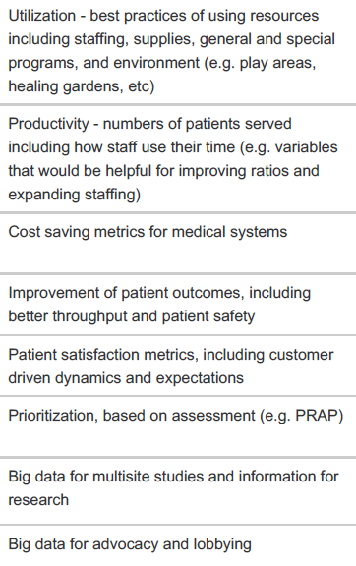
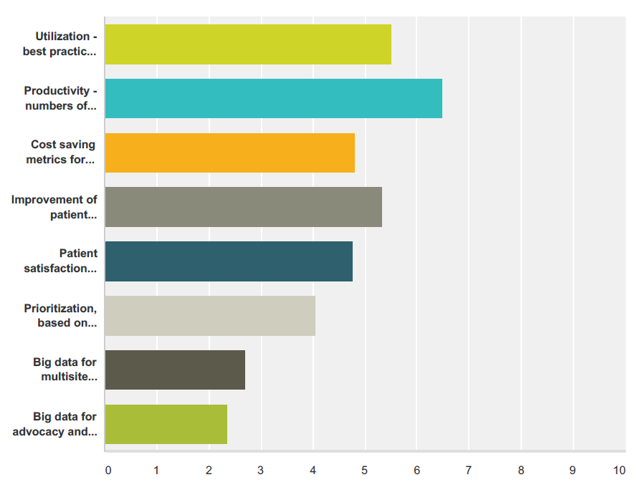
What data is important to you?
2
1
3
Notes:
Spend time going over each one….
Who? When?
Director conference survey – 2016
were asked to rate what is most helpful
obviously we want it all…
Results of survey
How we use data….Productivity, Utilization, and Improvement of Outcomes
We also know what is important to each of us by what we now call the “panic post”! The need for staffing, funding or program data, sometimes quickly, to hold onto or grow your program. The challenge is that while the data is interesting, it is not as useful as it can be as the comparisons are typically not coming from peer hospitals or child life programs.

Slide 7
How do we know what data is important?
We let evidence guide us.
Outcomes from psychosocial support include better coping, less sedation use, increased patient and family satisfaction, better communication and more.
Review of the literature: Published research shows child life impact in 6 distinct areas-
Acute Care
Critical Care
Radiology
Pre-Surgery
Outpatient Care
Emergency Department
Notes:
To try and tell a very clear story about the impact of the work of a child life specialist, we first turned to the research. The other two sub-committees spent last summer reviewing all of the existing published literature and research on the impact of child life interventions and there were clear positive outcomes shown: better coping, less sedation used, increased patient/family satisfaction, and better communication within the healthcare team.
Within the body of published evidence, there are 6 main areas of care where child life services were provided where the majority of outcomes were studied and shown. These include:
Acute care, inpatient units
Critical care
Radiology
Pre-surgery
Outpatient ambulatory care
and the Emergency Department

Slide 8
What are our new building blocks?
ED
Notes:
Using the positive outcomes associated with child life interventions and the six primary areas where outcomes were seen, we have come up with what we think will be a much clearer way to measure the role of child life: The Capacity for Patient Family Impact. It will look at how much care and intervention, thus positive outcome, can be achieved by child life specialists working in each of the six primary areas, as measured through patient/family encounters. This is a much simpler measurement than we have used in the past but one that we hope will really illustrate the impact of our services.

Slide 9
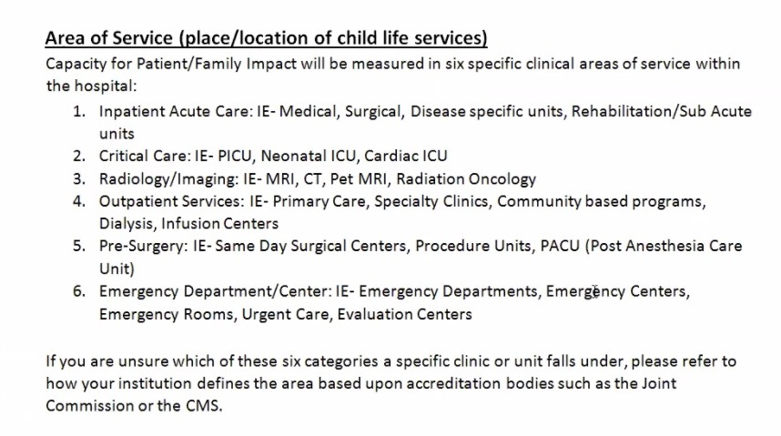
Definitions of Target Areas
Notes:
As you think about your own site and where your units and areas of care might fit within the six defined service areas, this slide can help explain better what is encompassed within each of these areas of service. Our recommendation if you are unsure about classification would be to ask the accrediting bodies at your hospital how the unit is categorized. For example, an observation unit may be considered outpatient or inpatient depending on your hospital’s classification. For the purpose of data collection, use your hospital’s recommendation.

Slide 10
Apples to Apples Comparison: Finding all the red delicious
Time:
Record the length of the assigned clinical care shift (for example, 4 hours, 8 hours, 12 hours, etc) based on area of assignment
Location:
Record the number of patient seen and provided with services during the shift in each area
Who:
Child Life Specialist providing the encounter
Notes:
So let’s look a little more at how the Capacity for Patient/Family Impact will allow us to compare data in a more useful and matched way. In this case, we are trying to make the shift from not just Apples to Apples data comparison but as granular as red delicious to red delicious or gala to gala. By recording time and patient/family encounters by area of service, the two main building blocks of Capacity for Patient/Family Impact, you will be able to compare the impact you have in any one of the 6 areas with your designated peer group and really drill down to information that is most comparable and relevant to your site. The Capacity for Patient/Family Impact allows us to tell the story: By providing x number of scheduled hours of support to the inpatient area for example, we have the ability to impact x number of patients and families each shift.
For data collection on an individual level, the consistent measurement for each specialist will be the length of their scheduled shift. In many cases, this might be data that as a program leader you already have access to, for example, through your timekeeping system. We actively chose to use scheduled shift vs. actual time worked for a few reasons- one, it is often consistent and will enable accurate (and easy!) data collection at your sight. Two, while there can be variation from day to day on a scheduled shift, whether someone leaves early for a doctor’s appointment or stays late to finish a patient care need, it balances out fairly consistently over time to equal the scheduled shift length.
We also want to utilize a full scheduled shift as the length of time to look at capacity for patient/family impact vs. just the time that is spent providing direct patient care. Again, this is a very deliberate choice. There are functions of a child life specialists’ job that have to exist outside of direct patient care in order to keep a program going- this includes things like toy cleaning, required trainings, precepting interns or new students, attending rounds and meetings, and many others. This takes up time in a day and needs to be considered as part of the equation when we consider what the capacity for patient/family impact and what a specialist could optimally achieve during a day when balancing all of the facets of the role.

Slide 11
What is defined as a patient encounter?
Total # of patients seen: any interaction with a patient, sibling, or primary caregiver (introduction of services, procedural preparation, phone call to prepare, when a child life specialist interacts with patient/sibling/caregiver in a playroom session, special event) associated with a unique MRN.
A CCLS can have more than one encounter with the same patient/sibling/caregiver tied to one MRN but it will be counted just once for that CCLS.
In the case of sibling transplant where the sibling has their own MRN, seeing the transplant recipient and sibling donor would count as 2 patients seen.
If more than one CCLS is assigned to a clinical area and both see the patient/sibling/caregiver tied to the same MRN in the same day, each would count it as 1 patient seen.
Notes:
The second part of the data for the Capacity for Patient/Family Impact is the number of patient/family encounters completed over the scheduled shift by the child life specialist. This is defined by counting the number of unique patient and family encounters a specialist has and the best way to describe this is related to the MRN. If a specialist saw the same patient or family multiple times on a shift, it would count as 1 patient/family encounter because the impact was only to one unique MRN, and capacity for impact was for just one family.
There will be times when a specialist may see siblings but each is considered a patient, for example when a sibling is a transplant donor and the other is a recipient, or an MVA that brings siblings into the Emergency Department. In this case, two MRNs are associated with the patients, and the specialist would be documenting their interventions in two charts- this would considered two patient encounters.
Across a day, you may have a child life specialist see a patient in the morning and a second specialist see the same patient in the evening. Each specialist would capture this encounter as 1 patient seen.

Slide 12
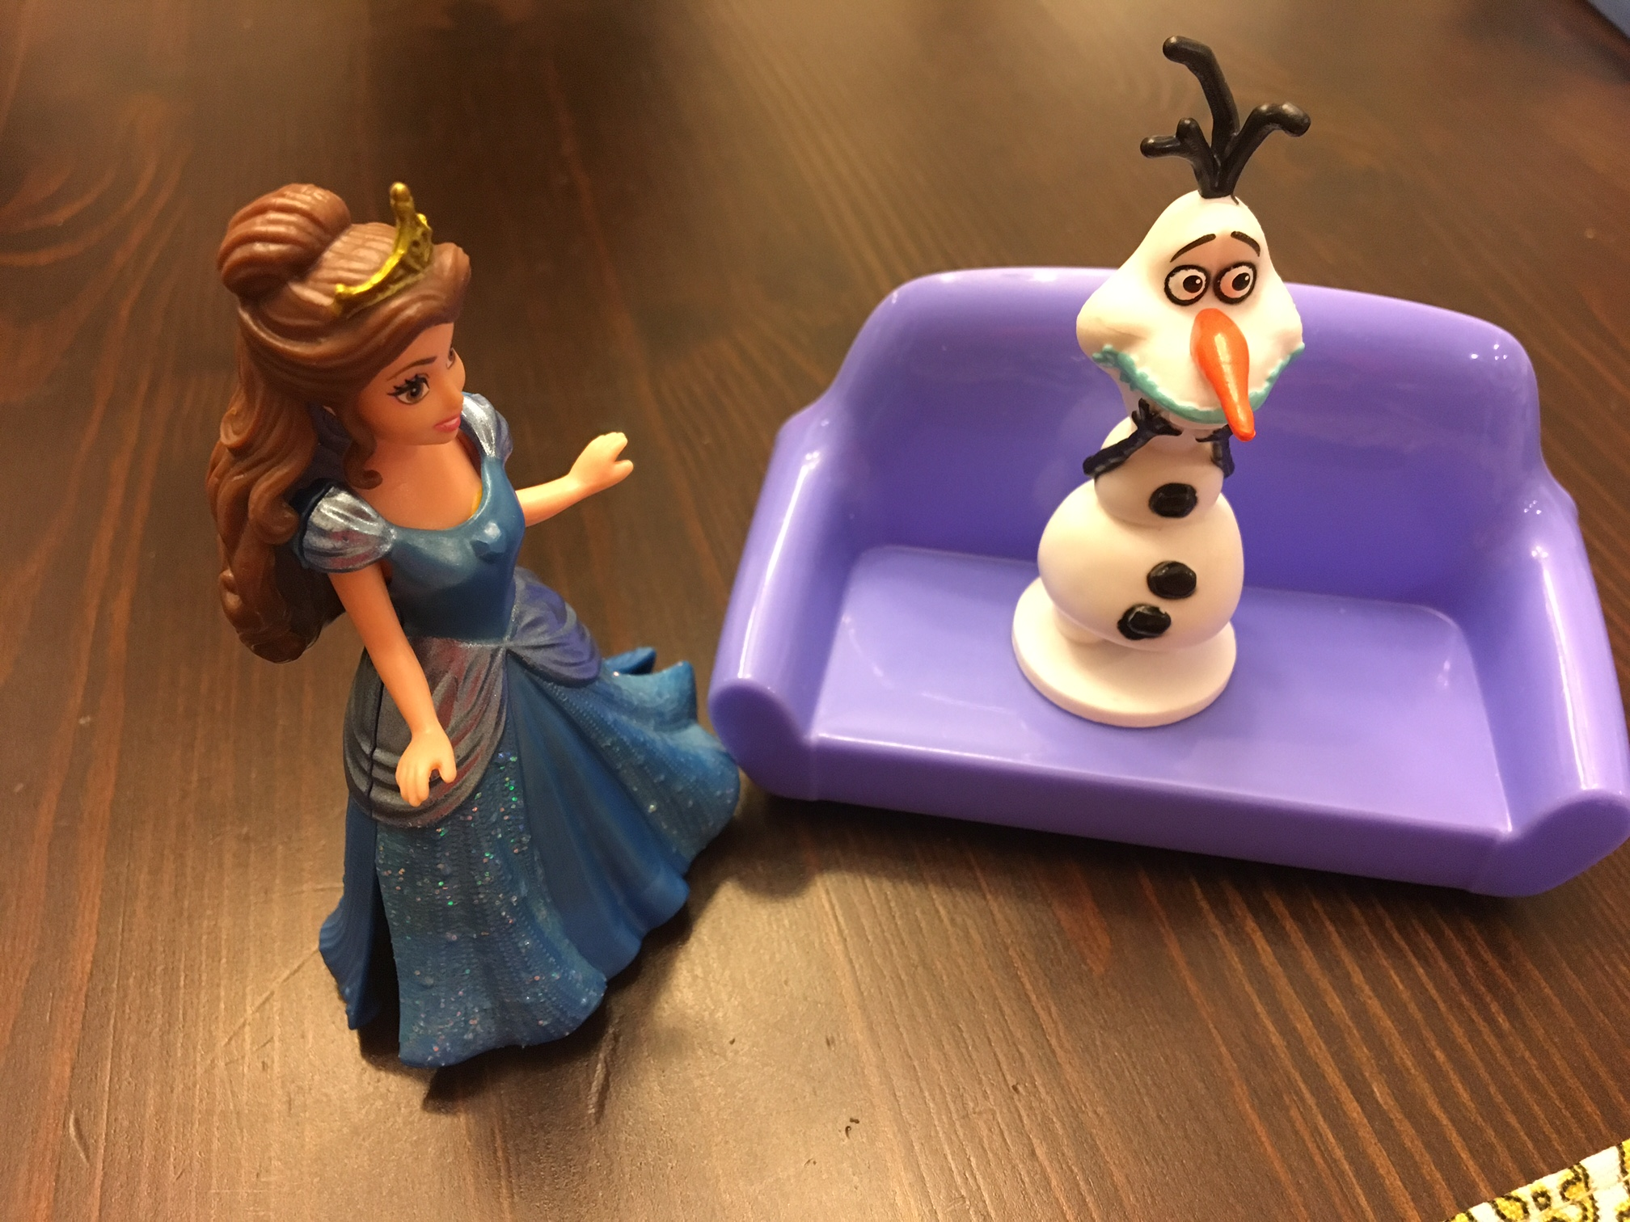
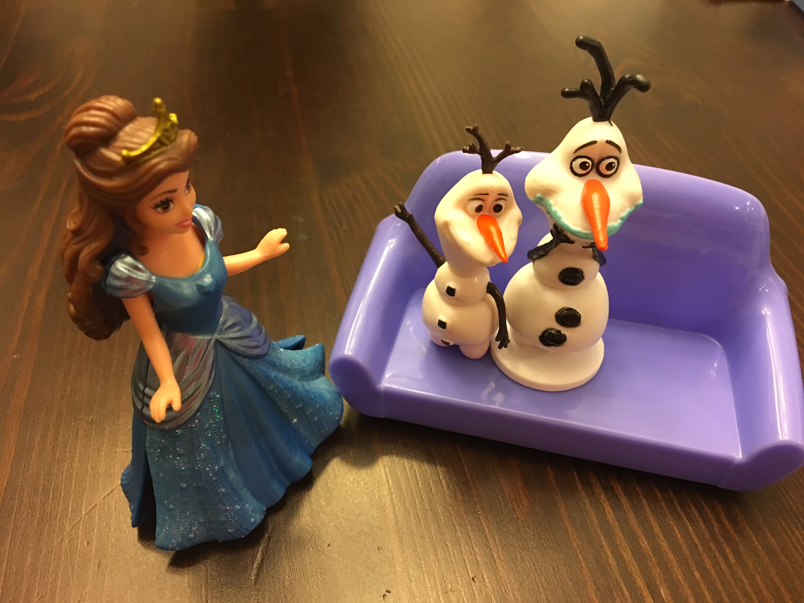
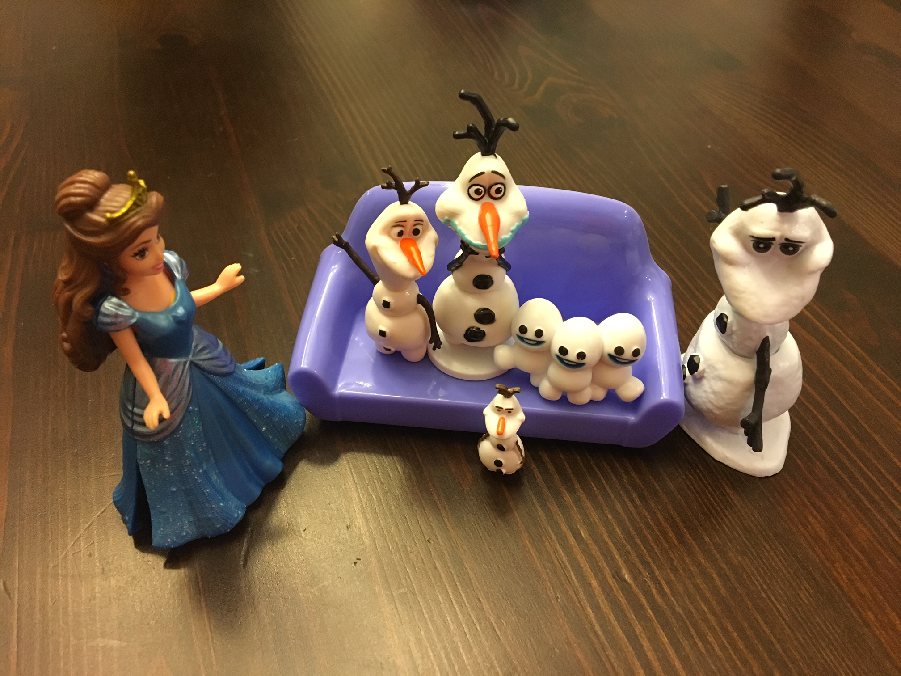
Example of Patient Encounter
Some days, Belle would see the same patient, Olaf, and his family multiple times. She would only count this as 1 patient encounter.
The same MRN would be used to document.
Notes:
Here is an example about Belle- a child life specialist working in an inpatient unit at National Snowman Hospital. Although she sees Olaf individually in the morning, with his mom in the afternoon, and his whole family after school, her impact is with only one patient/family so she would capture all three interventions as one encounter in the Acute Care area.

Slide 13
Determining where to log patient encounters
Scenario 1: Specialist spends 80% of time in primary unit but consults a patient in another area- count the encounter in the primary unit bucket not the area where service was provided.
OR
Scenario 2: Specialist spends shift in more than one area every day as part of their scheduled coverage- divide the time equally across the areas.
ie, 3 areas = 2.7 + 2.7 + 2.6 = 8 hrs
If the time spent is consistent, divide time accordingly.
ie, 2 areas = 30% (2.4) + 70% ( 5.6) = 8 hrs
Notes:
At many hospitals, child life specialists have a primary area of care where they provide consistent service, like radiology or an inpatient unit. However there are times when they may leave the unit to provide support in another area. If the specialist is spending 80% or more of their time linked to one primary area of care, then even if they provide an encounter in another area, they will still count it within their primary area’s total encounters for the shift.
You may also have a role of a float specialist or specialist who standardly splits their time between more than one unit on a consistent basis. For this case, the specialist would divide their total scheduled shift between the areas of coverage. For example, a specialist may cover an outpatient oncology clinic and the inpatient oncology unit. If they split their time evenly on a scheduled 8-hour shift, they would capture 4 hours in the inpatient acute care area and 4 hours in the outpatient area. They would then log encounters in each of these two areas for the day.

Slide 14
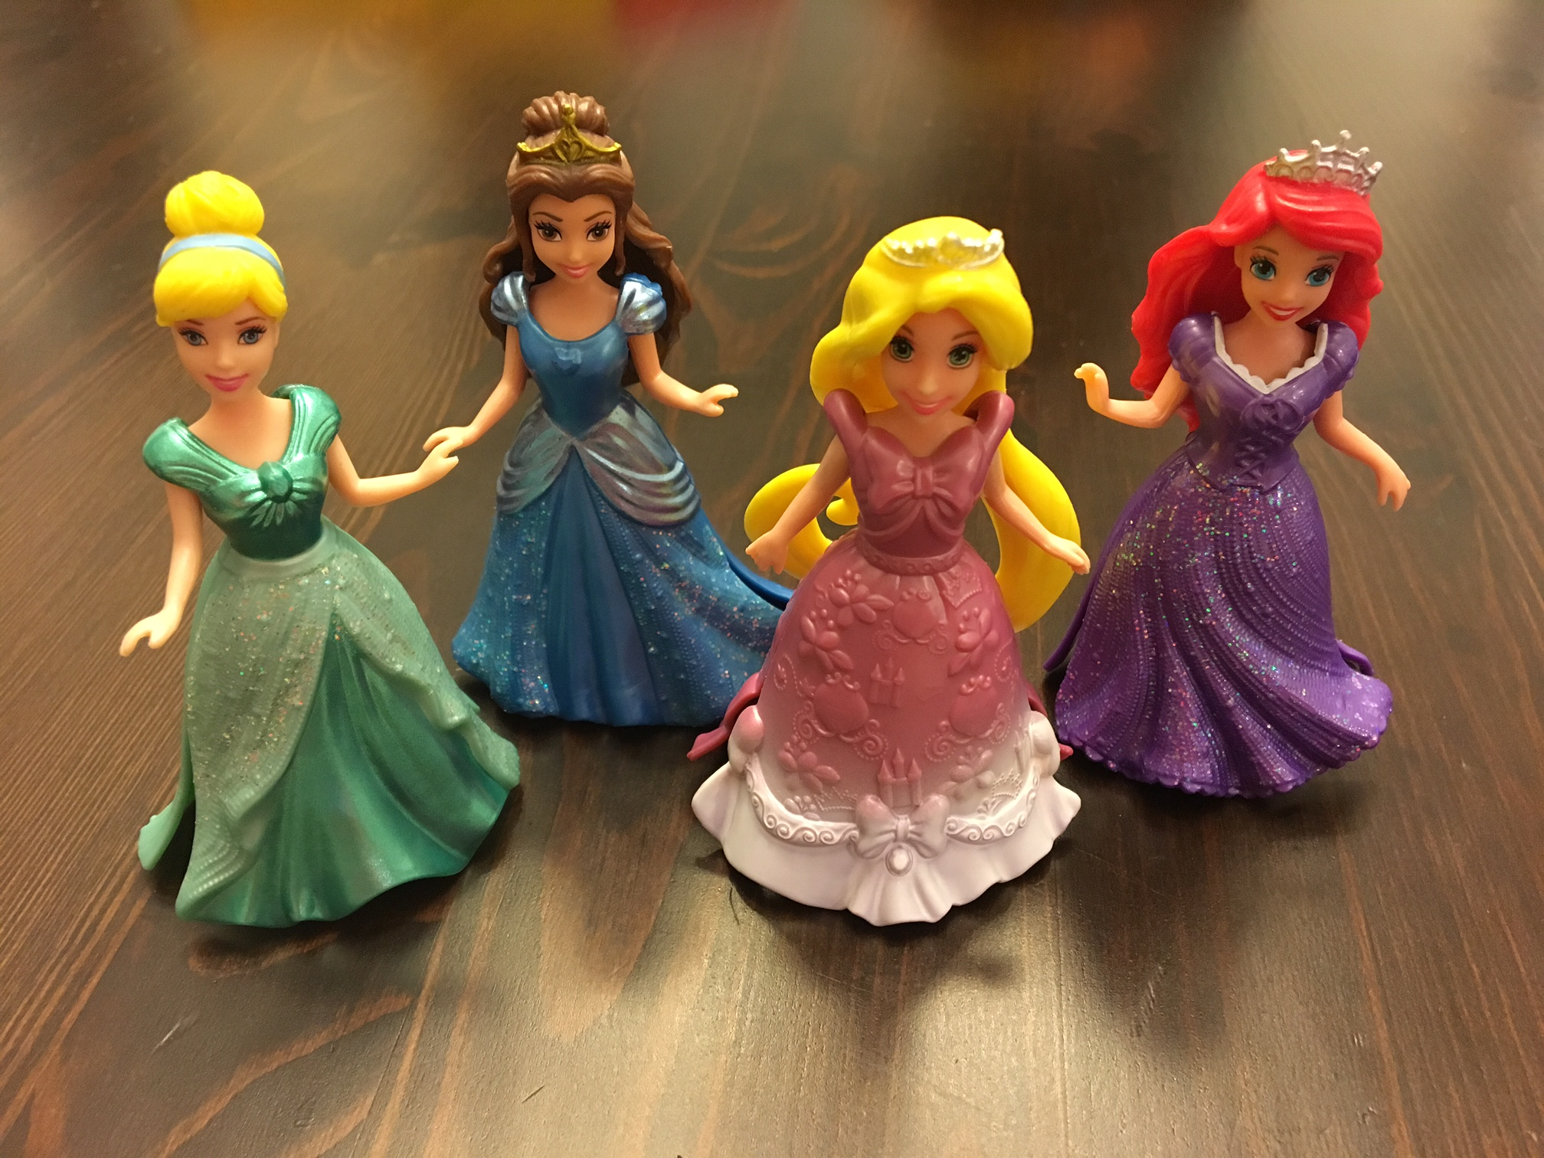
Area: =/> 80% services in one area
EXAMPLE:
Cinderella works an 8 hour shift in Acute Care inpatient. Usually, all encounters & scheduled hours would be recorded in the Acute Care bucket.
If Cinderella goes to the ED to see 1 patient, that 1 patient will be tallied in the Acute Care bucket along with all the other patients she sees that day in Acute Care Inpatient because she spends 80% or more of her time there.
Notes:
Here is an example of that 80% rule.

Slide 15
Float Position or Consult Staffing Model
Belle might see patients all over the hospital in her role of float. How does she capture this?
Time divided would be 2.7 hours Radiology, 2.7 hours Acute Care, 2.6 hours Critical Care.
Belle would list encounters in these 3 designated buckets.
Belle sees 3 patients in Radiology
Belle sees 6 patients in Acute Care-Inpatient
Belle sees 5 patients in Critical Care
Notes:
Now an example of a Float Position or Consults Staffing rule.

Slide 16
Understanding the use of the median to measure the number of patient encounters
Some days, Rapunzel is constantly running from one room to the next. On those days, her patient data was really high!
Notes:
Understandably in the role of a child life specialist, not every day is the same. There are circumstances where some days are very busy providing patient/family interactions, and others are less so. So when you collect your data each day at your site, it is important to understand how we will account for these fluctuations. For example, around the holidays, a child life specialist may have to go room to room to deliver a gift to each patient. In this situation, the number of patient/family encounters for the day might be very high because the specialist interacted with 30+ patients.

Slide 17
Understanding the use of the median to measure the number of patient encounters
Other days, Rapunzel had a chance to sit down and focus on some non-patient care activities, like trainings. On those days, her patient data was lower.
Notes:
There also might be days when the number of patient/family encounters is quite low- a day when the specialist is processing that donation of 400+ picture books that were donated or there is a mandatory training that takes up a big chunk of their day. Or if the city is experiencing some sort of weather that is impacting the number of kids showing up for their clinic appointment. There are many reasons why a specialist might have a particularly low number of encounters for a day.

Slide 18
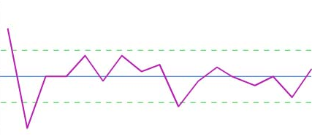
Over time, Rapunzel’s patients seen/hours worked looked like this:
To account for variation over time in how many patients are seen, the median will be used. Don’t worry – we will help you calculate this!
Notes:
This type of variation is normal and expected in the roll. The first thing we tell interns is to expect every day to look and feel different. By looking at data over time, a quarterly basis in this case, and looking at the median of the data (as opposed to the mean), we are able to account for and not allow significant outliers to affect the calculation. The median looks at the middle number of the data set, the most common number of patient/family encounters that occur within a daily basis over time.
Looking at the median provides for a higher reliability and pushes out the high and low days that has the potential to skew the data for what we are trying to obtain which is the capacity (of a child life specialist) for patient and family impact

Slide 19
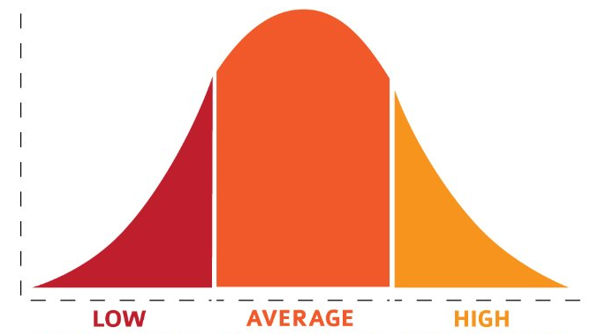
And all together, when everyone’s data is collected and compiled from many specialists or many sites, it might look like this:
Notes:
When we put everyone’s data together in one central place, we expect to see variation across all of our programs. This doesn’t just tell the story of differences in capacity for patient/family impact based on skill or speed of the child life specialists at a particular program but also tells the story of what else are those specialists responsible for or doing during their scheduled shift. For example, if you work in a one or two person program where the daily operations and support of your program are reliant on you, the capacity for patient/family impact may be lower because there are other responsibilities demanding your time. The Child Life Professional Data Center will allow you to compare and filter programs to find your peer group, in order for you to get a better comparison for this type of measure.

Slide 20
Data Collection Method
The Local Daily Productivity Data Collection Tool (word document or excel spreadsheet) is intended to be used by a specialist to record all patient encounters per scheduled shift, or “day” the specialist works. The term “local” refers to productivity data collected in the healthcare setting where the specialist works.
Notes:
What we have created if you choose to use these tools are an easy method for collection so that we are all collecting the same data
These tools are intended to be used by the individual specialist as well as the leader so that the data collection and entry can be streamlined for use

Slide 21
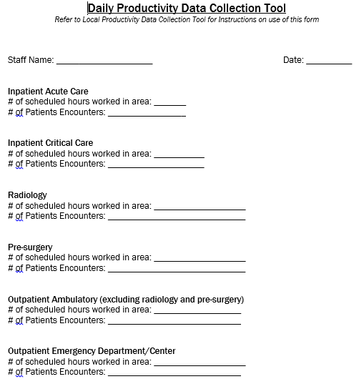
Word Document – Daily
Notes:
This would be the word document that the staff can use to collect daily data
Remember scheduled shift hours and patient encounters based on MRN

Slide 22
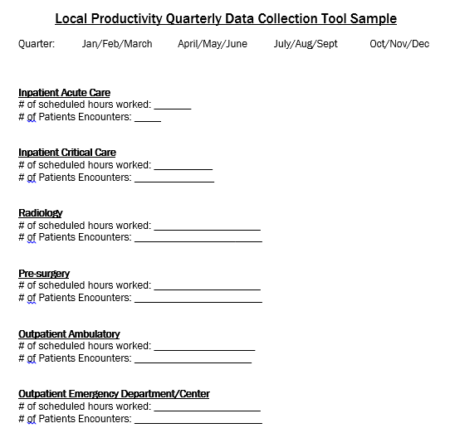
Word Document – Quarterly
Notes:
This would be the word document for the leader to use to collect and total the quarterly data which would then be entered into the CLPDC

Slide 23
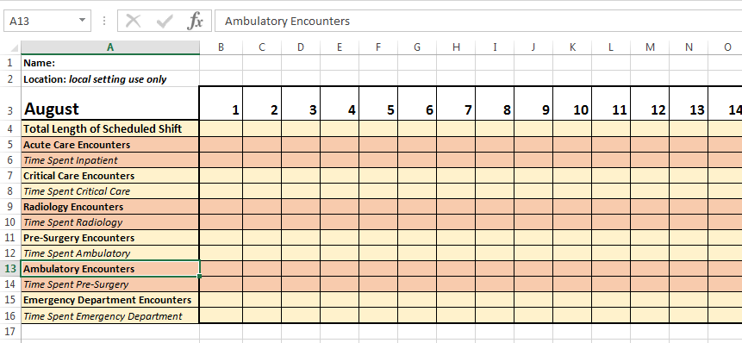
Excel Document – Daily/Monthly
Notes:
This is and example of the excel document that staff can use to enter their daily data which would then provided the leader with monthly totals
For those that are excel savvy you can utilize formulas to automatically formulate the quarterly totals from the monthly data
Out intention with providing these tools was to make it easier for you to participate and collect the data we all want/need to move our professional forward

Slide 24
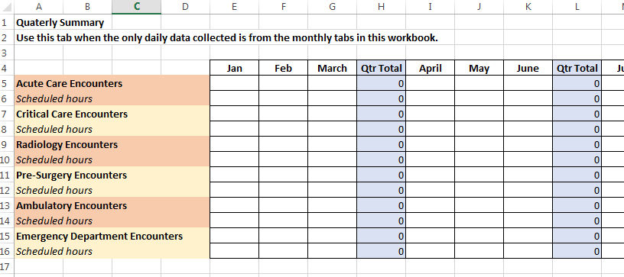
Excel Document – Quarterly
Notes:
This is the sample of what the quarterly data looks like in an excel format so that the leader would easily be able to record this in the CLPDC
These totals could be formulated from the previous daily/monthly excel tool and be populated into this document for leaders or the person designated to enter this info quarterly into the CLPDC

Slide 25
Instructions for Specialist
The sum of the # of hours worked per area in one shift should not exceed the total hours per specialist per scheduled shift.
Record # of patient encounters based on the location where the patient was seen.
If a specialist is assigned to an area and works there 80% or more of the scheduled shift that day, all patient encounters are recorded for the “primary” work area.
If a specialist is assigned to cover more than one area for the shift and the time spent in each area varies due to patient or other needs, the specialist divides the shift equally between areas. This process accounts for the notion that the time spent in the areas changes from day to day, but for the most part averages out. The specialist accurately documents the # of encounters in each area per shift.
If a specialist is partially clinical but also has additional assignments outside of clinical care, truncate the shift accordingly.
Notes:
Remember the # of hours worked are the scheduled hours for that specialist.
If the child life specialist is scheduled for 8 hours but works 9 that day….8 hours are recorded….remember we are collecting median data
We know that there are days where specialists work more or less…it’s all ok. We are collecting the median data for scheduled hours worked
Patient encounters are based on the MRN for a patient and family
80% rule…if child life specialist is assigned to a unit that is where the encounters are recorded
If the specialists works in various units/dept. then account for the time i.e. 2 hours, 2 hours, and 4 hours…and record the appropriate encounters in those buckets

Slide 26
Instructions for Program Leader
Excel Spreadsheet. The Program leaders would refer to the quarterly summary tab of the workbook to locate data for entry into CLPDC Quarterly Productivity Dashboard
Word Document. The program leader would collect the Local Daily Productivity Data Collection Tools per quarter from all staff. The program leader totals both scheduled hours and patient/family encounters as described below.
Sum # of scheduled hours worked per Inpatient Acute Care. For example, if a program has 2 FTEs who collected data for Inpatient Acute Care for that quarter, all of their scheduled hours are added up and entered into the CLPDC Quarterly Productivity Dashboard.
Sum of patient encounters per Inpatient Acute Care. For example, if a program has 2 FTEs who collected data for Inpatient Acute Care for that quarter, all of their patient encounters are added up and entered into the CLPDC Quarterly Productivity Dashboard.
The process is repeated for each of the six Areas of Service each quarter
The process to total scheduled hours and patient encounters is the same, regardless of how many FTEs are on staff
Notes:
As the leader or designated data collector/reporter you would collect the data from your staff…both the sum of scheduled hours and the sum of the encounters to report to the CLDPC
This will be done for each of the six designated areas that we are collecting at this time
If you only have staff in 2 of the 6 areas then that is what you report…this is for all sizes of child life professionals to collect and report

Slide 27
With change comes emotions: Supporting staff
Notes:
You might be feeling an array of emotions right now after taking in all of this information. We understand that many emotions come with data collection – even for teams who are used to it. We also understand that we have to help guide our staff through these emotions, dependent on where they are, for the successful implementation of accurate data collection.
Inside Out - Meet Your Emotions - Joy, Sadness, Anger, Disgust, Fear – https://www.youtube.com/watch?v=2WpKGqYAClk
You can play this video for your staff if you’d like to help talk about how we all fee about data collection.
Remind your staff this is not punitive and it’s going to help us grow as a profession. When we have this validated research and data to support what we are doing it will only make us collectively stronger and increase our services to our patients and families.

Slide 28
Introducing “FEELINGS” around PRODUCTIVITY and DATA COLLECTION
Who Are You Today? Who Will You Be Throughout This Process? Who Will We All Be When We Have Data Collection Center?
Notes:
Joy- She is lighthearted, optimistic and determined to find the fun in every situation. Joy sees challenges as opportunities, and the less happy moments as hiccups on the way back to something great.
Disgust- Disgust is highly opinionated and extremely honest. She keeps a careful eye on people, places and things that can get in the way or come up. Disgust always has the best of intentions and refuses to lower her standards.
Anger- Anger feels very passionately about making sure things are fair. He has a fiery spirit and tends to explode (literally) when things don't go as planned. He is quick to overreact and has little patience for life's imperfection.
Fear- He is constantly on the lookout for potential disasters, and spends time evaluating the possible dangers, pitfalls and risk involved. There are very few activities and events that Fear does not find to be dangerous and possibly fatal.
Sadness- Sadness would love to be more optimistic and helpful, but she finds it so hard to be positive. Sometimes it seems like the best thing to do is just lie on the floor and have a good cry.
We would like to help support you through these emotions and understanding of the data collection, so that you will be set up for success to support your own staff. So, as you continue to process through your current emotions, let’s jump over to the most exciting piece of this Webinar.

Slide 29
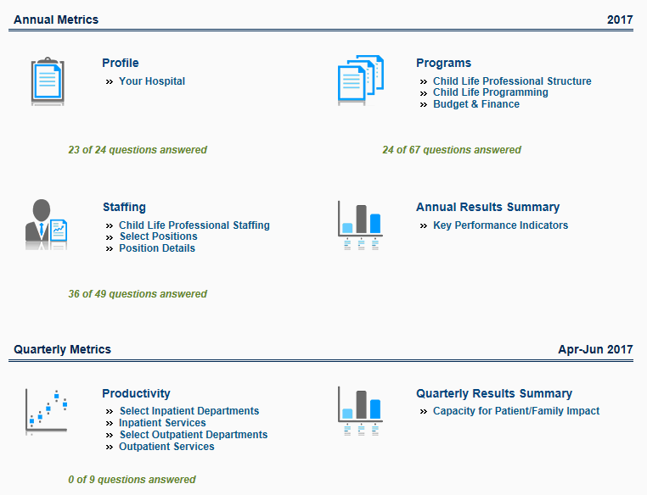
Child Life Professional Data Center (CLPDC) Website
Notes:
Okay- here is the amazing part of this webinar…for the first time, we have the platform: the Child Life Professional Data Center as a way to collect, analyze, and provide benchmarking and comparison as never before. We are incredibly grateful to ACLP for recognizing the limitations of our past self-managed attempts (excel spreadsheets!) and they committed the time and money necessary to engage with an outside vendor to create this robust platform. This is a screenshot of the landing page for the Data Center. You will be connecting to it directly through the ACLP website.
Since September, we have been working with a group called Dynamic Benchmarking to build a comprehensive data center that will allow for robust capture of information that is essential to our programs and with the functionality of analytics and filtering and reporting tools that we’ve never had available before. While we have had the generous support of the ACLP to build this platform, we are still in the exploratory phase of determining the annual maintenance expense of the Data Center. With this, we want to share that while everyone will have access in the years to come to much of the basis data and features of the site, there will be a need in the future for an annual subscription fee that will allow full access to all of the advanced analytics built in- the fee will allow continuous maintenance and any necessary future revisions.
Now let’s look closer at what the Data Center will capture and be able to provide to you. In the bottom half of the screen, you’ll see the Quarterly Metrics section- this is where the Capacity for Patient/Family Impact data will be entered on a quarterly basis. At the top of the screen is the Annual Metrics section. This is where all of the information related to your hospital and program is housed. We hope that it will be a solution to those immediate or urgent requests that come across the Director’s forum. The types of information that will be entered into the annual metrics will be information related to:
Your hospital structure- free standing vs. hospital within a hospital, etc; types of medical services provided
Your program- your child life staffing model, hours and areas of coverage, weekend and holiday support, spaces for play and families, and complementary programming: creative art therapies, facility dogs, medical clowns, etc
Your budget- how your program, child life staff, and other staff are budgeted: operational, donor, grants, etc.
To make it easy for you to find and identify these metrics before trying to enter everything into the data center, you will be able to download an excel spreadsheet that lists each data point. You can pre-fill this to use as a guide or share it with those people at your institution who may be helping to provide information, like a business director. The annual data section will launch for data entry beginning in April and you will be answering questions based on your current staffing and budget, not forecasted numbers. You also are able to edit your data at anytime during the year if there are significant changes.

Slide 30
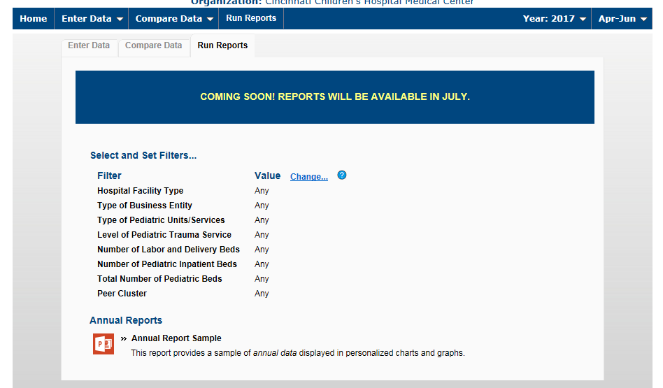
Child Life Professional Data Center (CLPDC) Website
Notes:
In order to get that Apples to Apples (or Granny Smith to Granny Smith) experience, you will be able to filter and compare data based on many different variables so you can create a peer group that is most appropriate based on what you are benchmarking. The data entered for every question can be reviewed and compared with simple tools and it presented in a number of formats, like powerpoint, excel, word, or PDF format, making it so easy for you to view and understand the reports and comparison features built into the data center.

Slide 31
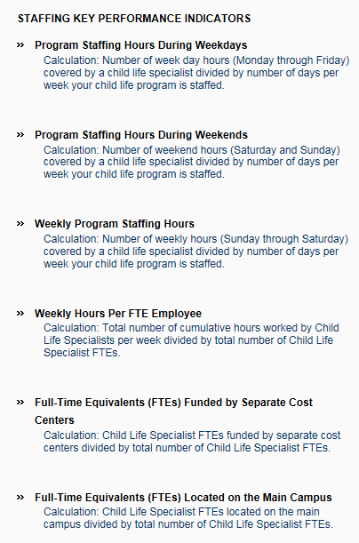
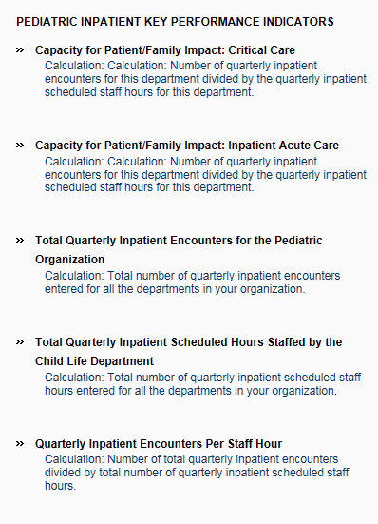
Child Life Professional Data Center (CLPDC) Website
Notes:
You will have access to quarterly and annual reports that you can run on-demand. The quarterly data highlights the capacity for patient/family impact and allows you to filter the results to find your peer comparison. The reports built of annual data, examples as shown on the right side of the screen, will allow you to examine budget, staffing, and program comparisons.

Slide 32
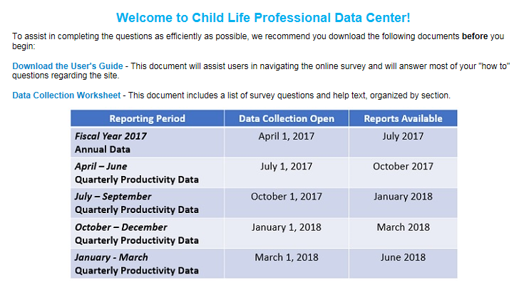
Timeline of Data Collection
Notes:
The Child Life Professional Data Center will be set to open on April 1st for annual data metrics to be entered by each site and we expect that the comparison and reporting features will be available in July, allowing for a three-month window for programs to be able to start entering data. Quarterly data will be entered beginning in July for the quarter of April-June. Reports from the first set of quarterly data will be available in October.

Slide 33
Next steps:
Login to the CLPDC starting April 3, 2017 and start to become familiar with the sections and survey questions.
All supporting documents are located on the CLPDC landing page and inside the platform for easy access.
Contact ACLP at datacenter@childlife.org to join a peer group to provide support during the first year of data entry.
View future webinars to explain the Compare and Reports tab and how to use the analytics in the platform.

Slide 34
Thank you to the ACLP members who contributed to the building of the Benchmarking Platform Patient Ratio Task Force Scientific Advancement of Professional Practice Subcommittees: Research Proposals Education, Outreach, & Awareness Benchmarking & Datacenter

